Slide 1
Classification – Decision trees
V.Jothika
S.Kamatchi
II – MCA ‘A’

Slide 2
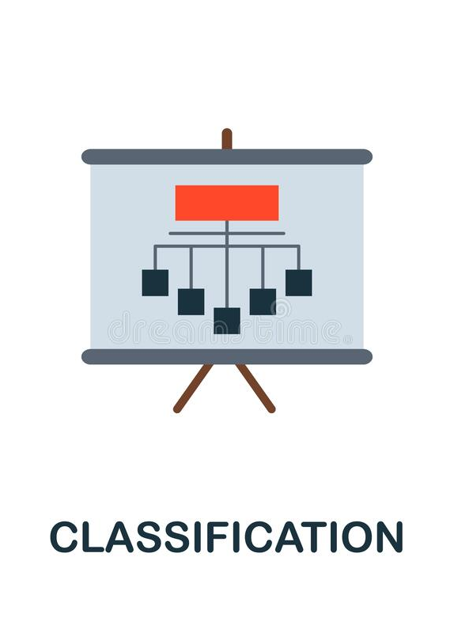
What is classification ?
Classification is the process of dividing the datasets into different categories or groups by adding label

Slide 3

Decision Tree
It is a graphical representation for getting all the possible solutions to a problem/decision based on given conditions.
A decision tree (also called prediction tree) uses a tree structure to specify sequences of decisions and consequences.
Similar to a tree, it starts with the root node, which expands on further branches and constructs a tree-like structure.

Slide 4


